Slide 1
Data Science Applications: NLP, Computer Vision, IoT (UCS672)

Slide 2
Use case: Smart Cities
Smart City
Use ICT (sensors, sensor networks, actuators, RFID etc.)
Makes regular infrastructure more accessible and interactive
Why do we need smart city?

Slide 3
Key Application Areas of Smart City
Smart Governance
Smart Economy
Smart People
Smart Mobility
Smart Environment
Smart Living

Slide 4
Current Focus Areas
Smart Homes
Smart Vehicles
Smart Health
Pollution and crisis monitoring
Smart Energy

Slide 5
Challenges in Building Smart Cities
Security and Privacy
Heterogeneity
Scalability
Reliability
Big Data Analysis

Slide 6
Data Fusion
Enables optimum utilization of massive data gathered from multiple sources across multiple platforms
Stages
Decision Level
Feature Level
Pixel Level
Signal Level
Mathematical models for data fusion
Probability-based methods
Bayesian Analysis, statistics
AI-based Methods
Machine Learning, ANN, Deep Learning, CNN
Theory of Evidence based Methods
Belief functions

Slide 7
Role of AI in IoT Decision Making
AI is a big helper in enabling IoT systems
Highly accurate decision making

Slide 8
Use Case: Smart Energy Grid
Traditional Energy Grid
Centralized
Unidirectional distribution of energy
Monitoring and maintenance are usually done manually
Smart Energy Grid
Use ICT to make the reliable power system
Cyber-physical System
Bidirectional

Slide 9
Smart Grid
Definition by NIST:
A smart grid is a modernized grid that enables bidirectional flows of energy and uses two-way communication and control capabilities that will lead to an array of new functionalities and applications

Slide 10
Benefits of Smart Grid
Better integration of customer-owner power generation systems
Improved security
Efficient transmission, quicker restoration and reduced cost
Identify peak demand

Slide 11
Benefits to Customers
Program their smart appliances to run during off-peak hours to lower their bills
Updated information on energy usage in real time
Enjoy different pricing options

Slide 12
Properties of a Smart Grid
Customer participation
Real-time pricing
Distributed generation
Power system efficiency
Power quality

Slide 13
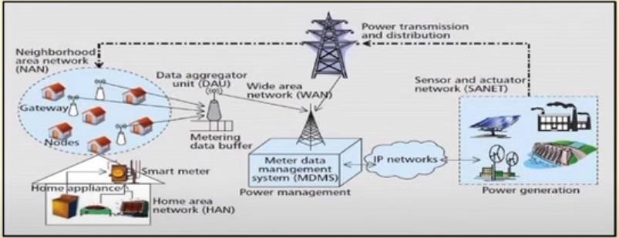
Architecture of a Smart Grid
Source: D. Niyato and P. Wang, IEEE CM, 2012.

Slide 14
Smart Grid Communication
Energy flow and information flow
Components of communication
Smart home appliances
Smart Meters
Gateways
Data aggregation units (DAUs)
Meter Data Management Systems (MDMS)
Networks associated with communication
Home area network (HAN)
Neighborhood area network (NAN)
Wide area network (WAN)
IP network
Sensor and Actuator Network (SANET)

Slide 15
Components of Smart Grid
Smart home
Smart metering
Smart appliances
Home power generation system
Consumer engagement
Time-of-use pricing
Financial incentives
Operation Centre
Monitoring and controlling transmission systems
Phasor measurement units (PMUs) – dynamic energy distribution
Collection of PMUs – Phasor network
Phasor network fed information further to SCADA (Supervisory Control & Data Acquisition)
Distribution Intelligence

Slide 16
Smart Grid Security
Integrity
Availability
Physical Threats

Slide 17
Collaborating Cloud Technology with Smart Grid
Energy Management
Information Management
Security

